Slide 1
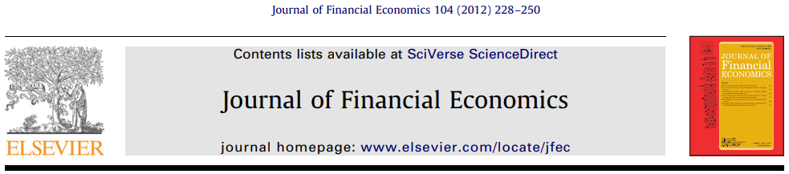

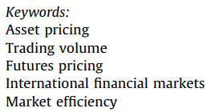
財務統計方法 Paper Presentation Time Series Momentum
(Citations: ~1120)
Reporter: 資科工博 廖家鴻 0786009 2020/12/24
Notes:
我是今天的報告人
今天的paper題目是time series momentum 時間序列動量
而它是2012年發表在journal of financial economics，並且1120個citations

Slide 2
Outline
1. Introduction
2. Data profiles
3. Time series momentum: Regression analysis and trading strategy
4. TSMOM factor: Factor analysis and performance in extreme markets
5. TSMOM vs. XSMOM
6. Who trades on trends: Speculators or hedgers?
7. Conclusion
時間序列動量: Time series momentum (TSMOM)
橫截面動量: Cross-sectional momentum (XSMOM)
Notes:
首先會簡介這篇paper的先備知識以及我覺得的看點有哪些。
第2節會介紹作者用的58種期貨的panel data profile
第3節把現在的自己和過去的自己做迴歸分析，並找出交易策略的參數。
第4節會詳細說明時間序列動量return的定義，做相關factor analysis，以及在極端市場中的表現。
第5節研究了時間序列和橫截面動量之間的關係，顯示了TSMOM是XSMOM的主要驅動因素。
第6節研究了TSMOM的time evolution及其與投機者與對沖者的頭寸分析。
第7節則做總結。

Slide 3
1. Introduction

Slide 4
Abstract
We document significant “time series momentum (TSMOM)” in equity index, currency, commodity, and bond futures for each of the 58 liquid instruments we consider.
We find persistence in returns for 1 to 12 months that partially reverses over longer horizons, consistent with sentiment theories of initial under-reaction and delayed over-reaction.
A diversified portfolio of TSMOM strategies across all asset classes delivers substantial abnormal returns with little exposure to standard asset pricing factors and performs best during extreme markets.
Examining the trading activities of speculators and hedgers, we find that speculators profit from TSMOM at the expense of hedgers.
Notes:
這篇paper記錄來自四大類期貨：股指，貨幣，商品和債券等58種流動工具中，有顯著的“時間序列動量”effect。
1.第一個發現是動量造成的return會持續1到12個月，然後會部分逆轉，這與最初反應不足和延遲過度反應的sentiment theory一致。
2.跨所有資產類別動量的多元化投資組合可帶來可觀的異常收益，並且幾乎不暴露於標準資產定價因素，並且在極端市場中表現最佳。
3.考察投機者和對沖的交易活動，我們發現投機者從時序動量中獲利，並且以hedger作為代價。

Slide 5
Some Preliminaries
$${momemtum}_{t}=r_{t−k,t}^{}={price}_{t}^{}−{price}_{t−k}^{}$$
What is Momentum?
In the past, Newton intended to capture the concept of "the amount of movement“.
is the product of the mass and velocity of an object.
The analogy of "price trend" to "objects in motion": According to the principle of inertia, the rising magnitude for the security price represents its momentum for rising continuously.
TSMOM vs XSMOM?
TSMOM: focuses purely on a security’s own past return.
XSMOM: focuses on the relative performance of securities in the cross-section.
Some sentiment theory:
Initial under-reaction: For example, investors could not receive and digest the information timely, causing prices to fail to respond to the information immediately.
Delayed over-reaction: For example, investors overestimate the effectiveness of information, and the resulting price overreaction.
Notes:
接下來介紹一些preliminary knowledge:
一、以前牛頓意圖補捉「運動的量」這個概念。
將「價格走勢」類比成「運動中的物體」: 依據慣性原理，證券價格上漲的幅度代表其有持續上漲的動量。
二、
TSMOM主要只關注某種資產過去一段時間的return
XSMOM在過去一段時間內表現比其同類好的資產，會在未來一段時間內表現持續優於其他同類證券，關注的是不同資產之間收益情況的比較。 三、
例如投資者沒能及時接收、消化訊息，導致價格對訊息的反應沒辦法一步到位。
(反應不足：預測動量效應只存在於短期，會隨時間延長而逐漸消失)
例如投資者高估資訊的效益，因而產生的價格過度反應。
(過度反應：認為動量為短期偏離基本價值的泡沫，一但泡沫隨時間破裂，價格就會反轉)

Slide 6
1. Introduction & Highlights
Not issue oriented, this paper provide a series of verification method.
Identify the mechanism of momentum, and proof TSMOM outperforms XSMOM. (The momentum literature focuses on the relative performance of securities in the cross-section.)
Find the positive TSMOM effect that partially reverse after 1-year may be consistent with initial under-reaction and delayed over-reaction, which sentiment theories suggest can produce these return patterns.
Present challenges to random walk theory and efficient market hypothesis. (The TSMOM predictability is tested across very different asset classes and markets.)
Investors may be interested in:
Show evidence the speculators profit from the hedgers’ expense via TSMOM.
Show that a diversified portfolio of TSMOM across all assets is remarkably robust, yielding a Sharpe ratio greater than 1 on an annual basis, or roughly 2.5 times for the equity market portfolio.
TSMOM may be a hedge for extreme events, making its large return premium even more puzzling from a risk-based perspective.
Notes:
1這篇不是議題導向那種大眾也會想讀的paper
裡面有些結論都猜得到，問題是怎麼驗證？：此篇paper提供了各種方法來驗證。這類paper較是研究者和投資者會想讀的paper
2這paper identify出動量策略的機制，並指出大部分使用動量策略的文獻都是指橫截面動量。
並驗證了TSMOM比XSMOM策略好。
3作者發現長期部分逆轉的正time series momentum可能與最初的反應不足和延遲的反應過度有關
情緒理論可以解釋這種return pattern產生的原因
4這篇paper提供了強而有力的證據挑戰了random walk和efficient market這類hypothesis。
5最後是For投資者想知道的：
a投機者從TSMOM中獲利，而且是以hedgers為代價。(因為speculator向hedger提供流動性)。
b表明所有資產的TSMOM的diversified portfolio都非常robust，且sharp ratio每年大於1，大約是股票市場portfolio的2.5倍
c統計結果顯示TSMOM可能是對極端事件的避險工具
(雖然從基於風險的角度來看，其巨大的return premium甚至更加令人難以理解)

Slide 7
2. Data profiles Total 58 instruments from 4 classes of futures contract around 25 years (Commodity, Equity index, Bond, and Currency)

Slide 8

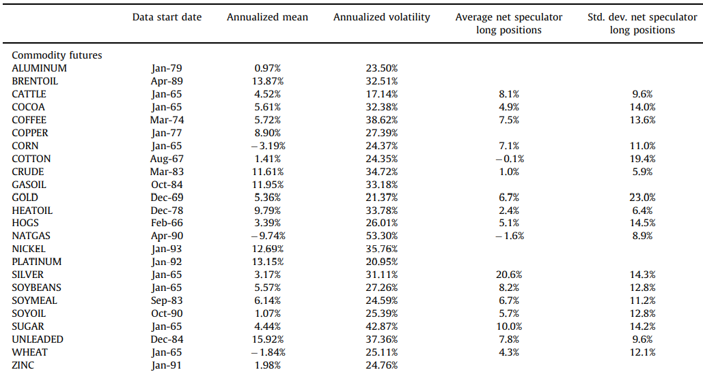
2-1. Data of Futures Contracts
Table 1 presents summary statistics of the excess returns on our futures contracts.
max
There is significant variation in sample mean returns and volatilities across the different contracts.
For example, the volatility of NATGAS futures is about 50 times larger than that of 2-year US bond futures.
Notes:
表1列出了所有期貨合約關於excess return的摘要統計。
1.第一行是data start date，
2.中間的兩行是每種合約的mean和variance。
3.不同合約的mean return存在顯著差異。
4.更引人注目的是各合約的波動率差異。 這邊只show出大宗商品期貨，其波動率也存在較大的橫截面變化。
5.在波動率差異很大的工具之間進行比較，是具有挑戰性的。 例如，天然氣期貨的波動率是2年期美國債券期貨的約50倍。
我們在下面討論我們在分析中如何處理此問題。

Slide 9
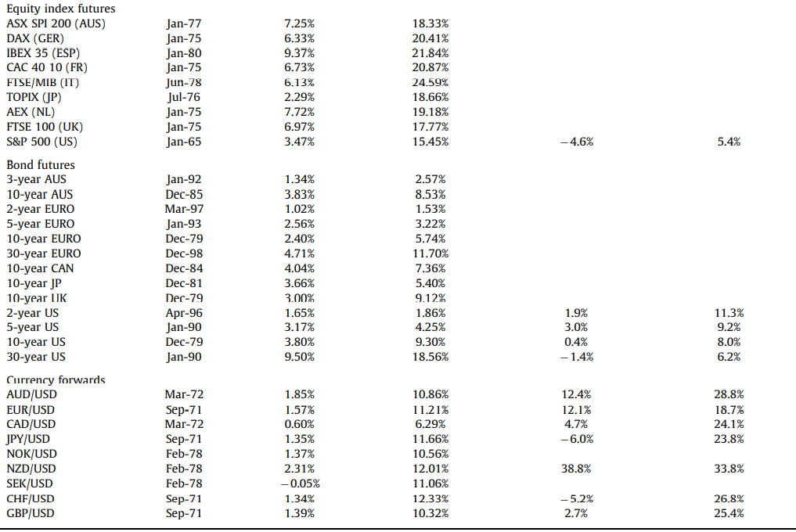
2. Data of Futures Contracts
We also use data on the positions of speculators and hedgers from the Commodity Futures Trading Commission (CFTC)
The CFTC requires all large traders to identify themselves as commercial (hedger) or non-commercial (speculator)
min
Since speculators and hedgers approximately add up to zero, we focus our attention on speculators.
Notes:
剛剛上一頁是商品期貨，而這頁呈現出股票，債券和貨幣 期貨 (volatility最小是1.53%)
我們還使用商品期貨交易委員會（CFTC）的speculator和hedger的position數據。
CFTC要求所有大型trader將自己識別為商業(hedger)或非商業人(speculator)
由於speculator和hedger的總和大約為零，因此我們將注意力集中在Speculator。
當然，這意味著net hedger position為net speculator的負數。

Slide 10
3. Time series momentum: Regression analysis and Trading strategy (Predictability and Profitability)
Notes:
接下來會用迴歸分析來看TSMOM的預測能力，然後再介紹基於TSMOM的交易策略。

Slide 11

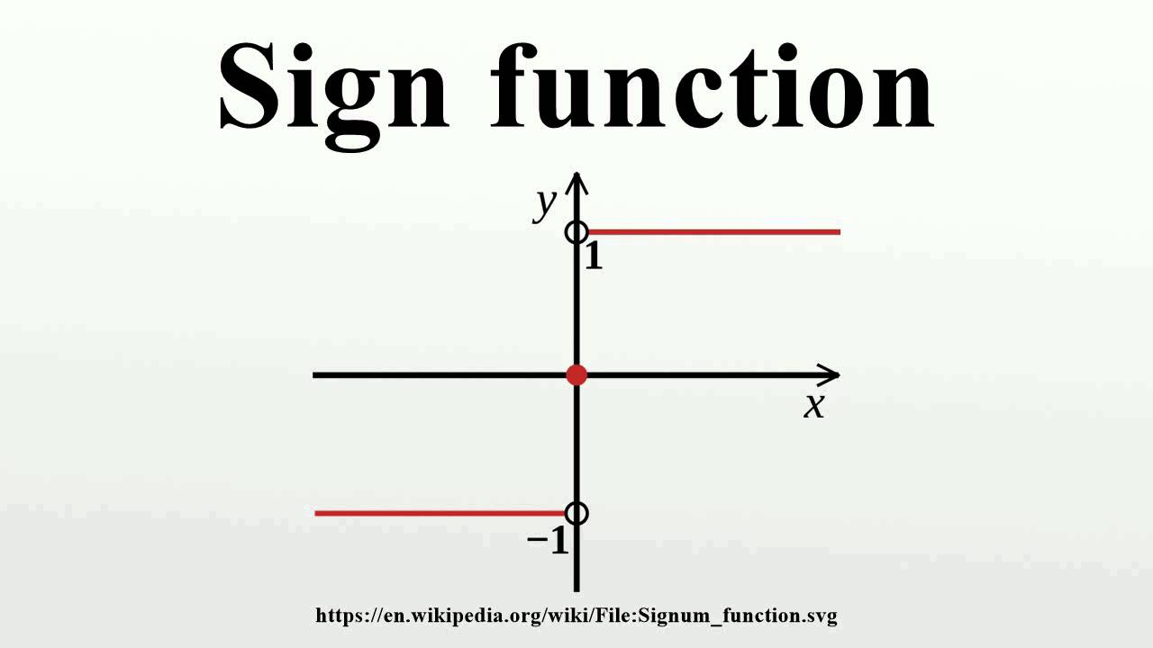
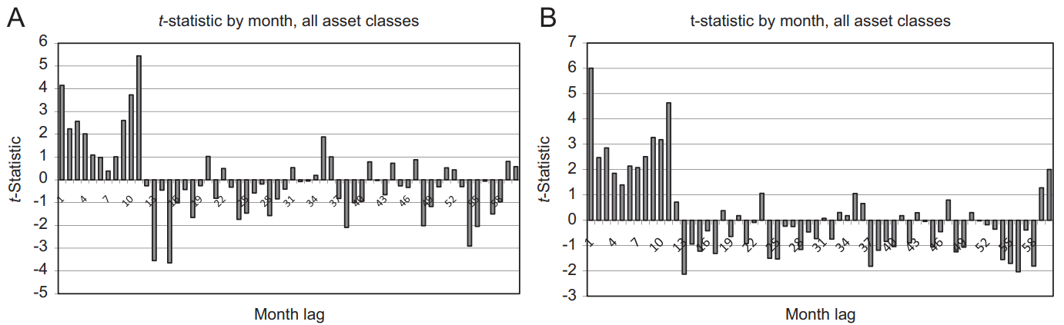
3-1. Regression analysis: examine the predictability of futures returns
Ex ante volatility:
Regression:
Panel A of Fig. 1 plots the t-statistics from the pooled regressions by month lag h.
Panel B does the similar pooled regression as Panel A, but change to only focus on the sign of the past excess return.
Notes:
1首先這是年化的事前波動度，時間的關係就不講細節，大家就先接受它。
2再來較重要的是當期return對過去h個月的return做regression，然後因為每個instrument s的mean variance差異很大，所以用volatility來normalize
3 panel A是第一個重要的圖，而這是不分期貨合約類別的pooled regression。
圖中show出h從lag 1個月到lag 60個月的t統計量，會發現h在過去1年內都是正值，而且有一半以上是大於2的。
而在一年後呈現負的相關，然後離當期愈久就愈不相關了。
4右式與左邊類似，只是將lag h個月的return值變成正負1的訊號。
5 panel B與A的趨勢類似，只是t統計量更佳地明顯。
------------------------------
時間序列（Time Series）動量，相對於橫截面（Cross Section）動量，是一個略不同且更新鮮的交易策略。以股票為例，橫截面動量就是某個時刻做多漲最多的，做空跌最多，即使當時沒有跌的股票，也會做空漲最少的股票。而時間序列則是如果過去漲了就做多，跌了就做空，所以可能某個時點都在做多或者都在做空，更類似追隨趨勢的概念。 總結一下，橫截面是橫向的不同股票間的比較，而時間序列是縱向的只考慮自己過去的趨勢。

Slide 12
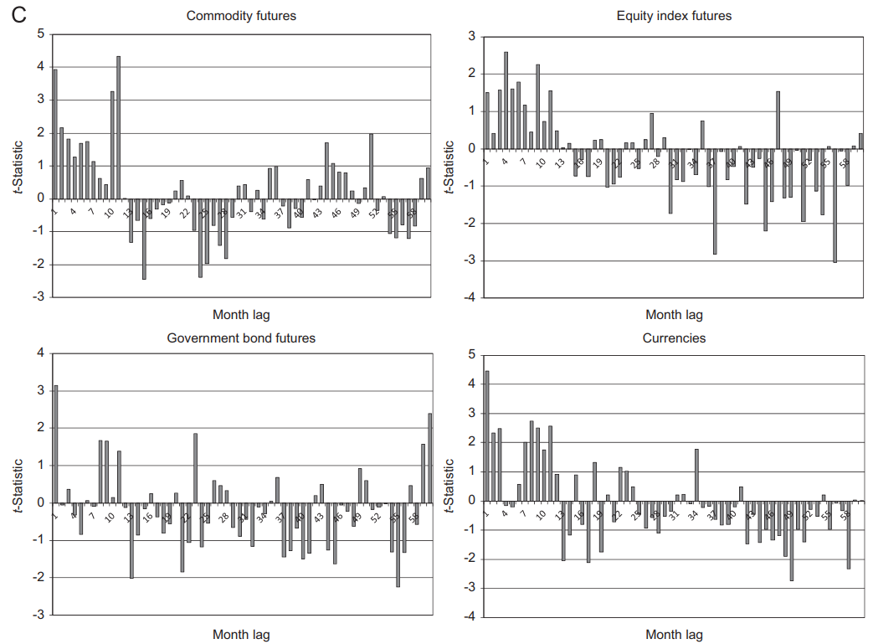
3-1. Regression analysis: Predicting price continuation and reversal
consistent with sentiment theories of initial under-reaction and delayed over-reaction.
Notes:
1Panel c的四個圖分別為四大類期貨分別regression的結果，會發現整體的趨勢，都跟前一頁的pooled regression相當類似。
2因此藉由回歸分析，可以發現動量訊號有 預測價格的延續和反轉的預測能力。
----------------------------------------------------
第一年的收益持續強勁增長，而接下來的4年的收益反轉較弱。 在這兩種情況下，數據均顯示出清晰的模式，所有最近12個月的滯後收益均為正（在統計上有9個顯著），其餘大部分滯後為負。
開始有”初始反應不足”和”延遲過度反應”的味道出來了，但這只是迴歸分析，更後面還會有更嚴謹的驗證。

Slide 13
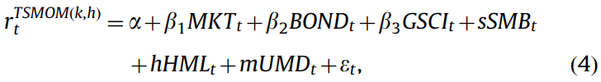




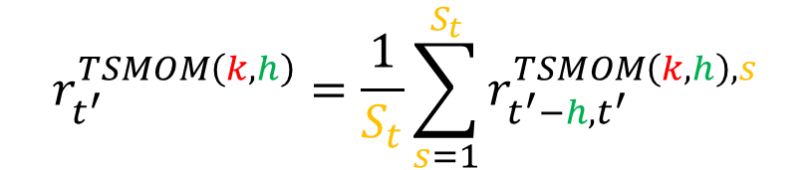



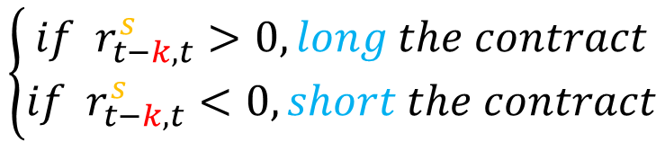


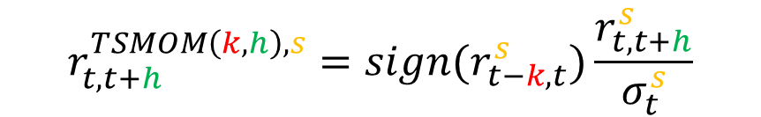


3-2. Trading Strategy: investigate the profitability TSMOM
(k,h) = (look-back period, holding period)
$$r_{t,t+h}^{TSMOM\left(k,h\right),s}=sign(r_{t−k,t}^{s})\frac{r_{t,t+h}^{s}}{σ_{t}^{s}}$$
$$\left\{\begin{aligned}if { r}_{t−k,t}^{s}>0, long the contract \\ if r_{t−k,t}^{s}<0, short the contract\end{aligned}\right.$$
Strategy:
Momentum signal
Example:
$${−6}_{i}$$
$${−1}_{e}$$
$$1_{i}$$
$$3_{e}$$
$$1_{i}$$
$$2_{e}$$
$$1_{i}$$
$$1_{e}$$
$$t$$
$$t^{′}=t+3$$
$$r_{t^{′}}^{TSMOM\left(6,3\right),s}$$
$$r_{t^{′}}^{TSMOM\left(k,h\right)}=\frac{1}{S_{t}}\sum_{s=1}^{S_{t}}{r_{t^{′}−h, t^{′}}^{TSMOM\left(k,h\right),s}}$$
Final time series:
Notes:
接下來要講解paper的交易策略
1首先k是動量訊號預計look back的k個月，h則是執行交易後hold h個月
2所以基於TSMOM的return，則是hold h個月後的return，乘以這個正負1的動量訊號，然後再除以事前波動度來normalize。
注意，若動量訊號大於零就做long，小於零就short。
3這裡舉某一個instrument s的k=6，h=3的情形，然後因為h=3，所以同時會持有3個portfolio，
所以同一期的TSMOM return需要把這三個平均起來，這是paper的做法。
4最後再因應分析的需要，將所有instrument，或者是同一類別的instrument的return平均起來。

Slide 14
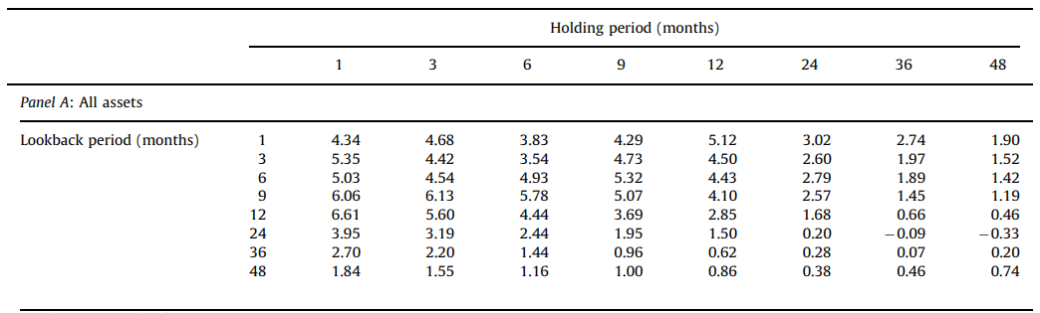
3-2. TSMOM Trading Strategies
From Jan. 1985 to Dec. 2009
MKT: stock market (MSCI)
BOND: (Barclays Aggregate Bond Index)
GSCI: commodity market (S&P GSCI Index)
SMB, HML, UMD : (Fama-French factors) size and value and cross-sectional momentum premiums
To evaluate the abnormal performance of these strategies, they compute the alphas from the following regression:
Table 2 panel A: t-statistics of the alphas of TSMOM strategies with different look-back and holding periods.
Notes:
1接下來再把上一頁算的TSMOM return塞到這個fama-French model做regression
2然後右邊這邊列出這些risk factor的data來源：
3-1接下來為了要evaluate TSMOM策略的performance，panel A只秀出alpha值的t-stats。
(look back從1月3月到48月前，hold 月份也是類似)
3-2然後會發現look back12個月，然後hold1個月的t-stats最顯著。

Slide 15
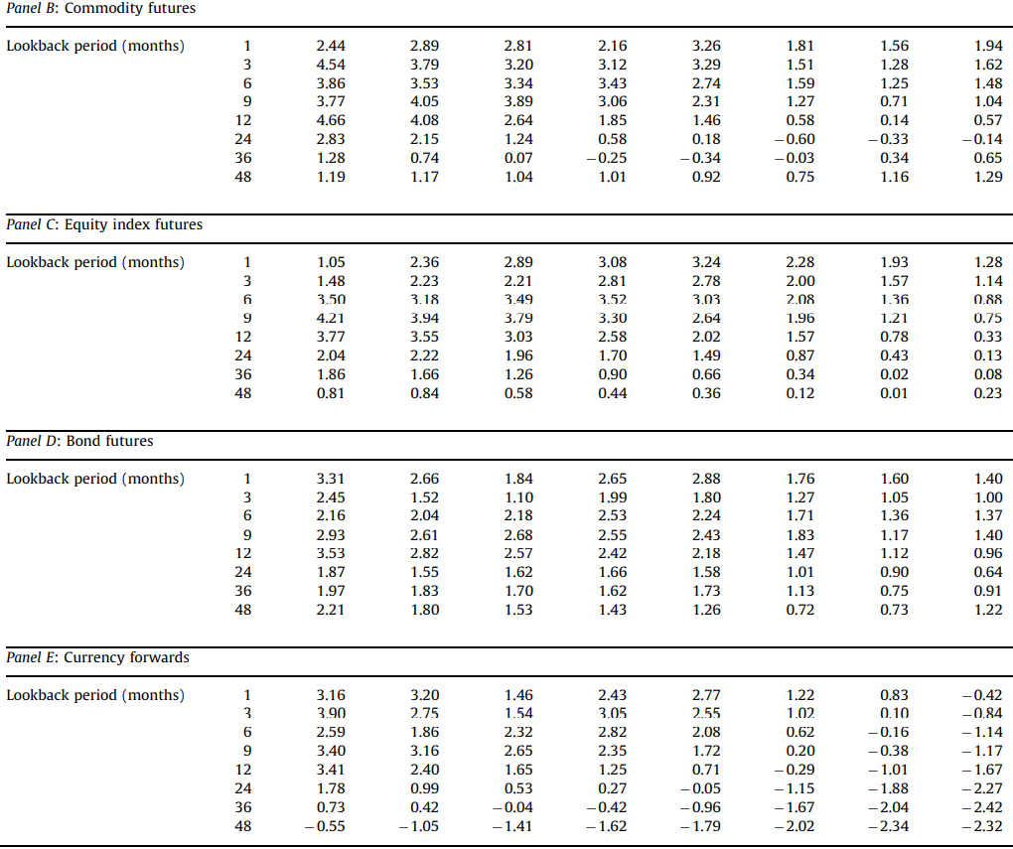
3-2. TSMOM Trading Strategies
h
k
Table 2 shows the t-statistics of the estimated alphas for each asset class and across all assets. The existence and significance of TSMOM is robust across horizons and asset classes, particularly when the look-back and holding periods are 12 months or less.
The largest t-statistics seems to happen when(k,h)=(12,1)
k
k
k
Notes:
1這個table與上一頁的table是一樣的，只是是分別對這四種期貨合約做regression，
然後列出不同(k,h)動量交易策略的alpha的t統計量。
2會發現TSMOM的存在和重要性在不同的time horizon和資產類別中都非常強大，尤其是當look back和hold period為12個月或更短時。

Slide 16
4. Time series momentum factor: Factor analysis and performance in extreme markets
Notes:
接下來要進一步探討TSMOM的影響因子，以及它在極端市場時的表現。

Slide 17

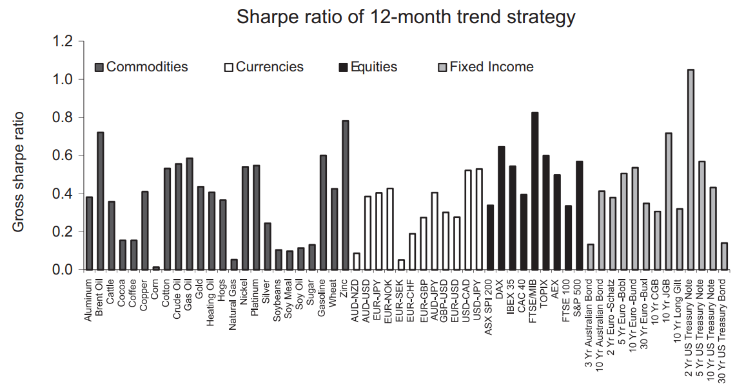
4-1. Annualized Sharpe ratios of TSMOM strategies
Note: (k,h)=(12,1)
As the figure shows, every single futures contract exhibits positive predictability from past one-year returns.
All 58 futures contracts exhibit positive returns and 52 futures are statistically significant.
Notes:
1圖2繪製了每種期貨合約的這些策略的年化的sharp ratio。
2如圖所示，每張期貨合約從過去的一年收益中都顯示出正面的可預測性。
幾乎所有品種的時間序列動量策略都是正收益，目測了下sharp ration0.2至0.6之間。
3所有58個期貨合約都顯示出正的TSMOM return，圖裡有52個在統計上是顯著的。
------------------------------
計算從1985年1月到2009年12月每個工具和每個可用月份的回報。

Slide 18

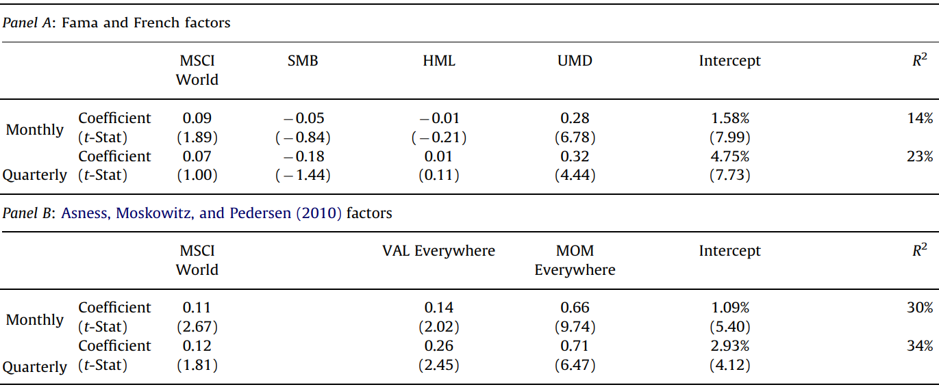
4-2. Alpha and Loading on risk factors
Note: (k,h)=(12,1)
cross-sectional factor
Because the alpha is still impressive for both Panel A and B, the returns to TSMOM are not fully captured by the cross-sectional factor.
Notes:
1剛剛在sec3看的是所有不同(k,h)組合的alpha值的t-stats。
而這邊我們特別看k=12、h=1這個TSMOM策略的regression細節。
2從panel A會發現market、size和value的beta不顯著，然後UMD這個橫截面factor以及alpha兩個顯著。
Monthly和quarterly都一樣。
3那panel B是拿別的文獻的data來跑regression，一樣是橫截面factor以及alpha兩個相對非常顯著。
4所以從這麼顯著買不低的alpha，會發現TSMOM的return沒辦法被橫截面factor完全解釋。

Slide 19
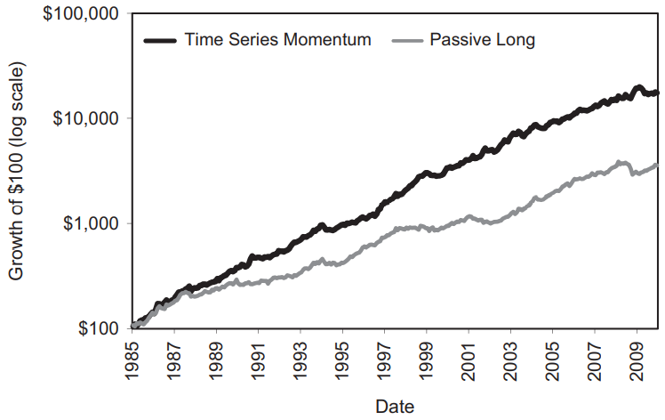
4-3. Performance over time and in extreme markets
Fig. 3 highlights that TSMOM profits are large in October, November, and December of 2008, which was at the height of the Global Financial Crisis when commodity and equity prices dropped sharply, bond prices rose, and currency rates moved dramatically.
Leading into this period, TSMOM suffers losses in the third quarter of 2008, where the associated price moves caused the TSMOM strategy to be short in many contracts,
setting up large profits that were earned in the fourth quarter of 2008 as markets in all these asset classes fell further.
Fig. 3 also shows that TSMOM suffers sharp losses when the crisis ends in March, April, and May of 2009. The ending of a crisis constitutes a sharp trend reversal that generates losses on a trend following strategy such as TSMOM.
Fig. 3. Cumulative excess return of TSMOM and diversified passive long strategy
Notes:
接下來我們來看TSMOM在極端市場時的表現。
1圖三是累積超額收益曲線圖，黑線是原本因應用動量訊號有時long有時short的收益曲線。
灰色線則是只long沒有short的曲線，所以它的收益會比黑線少沒錯。
2會發現在2008年9月 financial crisis失控的時候，TSMOM在2008第三季會先賠，然後到第四季大賺。
3然後在2009第二季危機解除時劇烈反轉，所以此時TSMOM賺了不少，然後再慢慢爬上來。

Slide 20
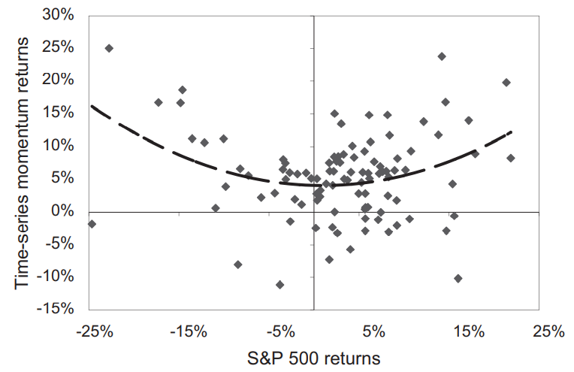
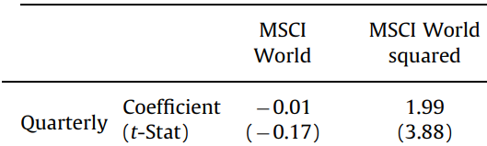


4-3. Performance over time and in extreme markets
Table 3. Panel C reports coefficients from a regression of TSMOM returns on the original and squared MSCI return.
$$r_{t}^{TSMOM\left(k=12,h=1\right)}$$
$$r_{t}^{TSMOM\left(k=12,h=1\right)}$$
While the coefficient on the squared MSCI return is significantly positive, indicating that TSMOM delivers its highest profits during the most extreme market episodes.
Fig. 4. the TSMOM returns against the S&P 500 returns.
As shown by the Fig. 4., the returns to TSMOM are largest during the biggest up and down market movements.
Notes:
接下來圖4繪製了TSMOM回報與標準普爾500回報的關係，明顯是一條smile二次曲線。
1可以看出在最大的市場波動中，TSMOM的收益跟著變大，即使在股市場大賠的時候，TSMOM在期貨的表現大賺。
2表3的C面板報告了TSMOM return對MSCI的平方呈現顯著關係。
儘管市場上的貝塔係數微不足道，但市場收益平方的係數卻顯著為正，這表明TSMOM在最極端的市場事件中實現了最高利潤。
因此，TSMOM的收益類似於跨市場的期權。
--------------------------------------------------------
Fung和Hsieh（2001）討論了趨勢追踪為何具有跨步式收益，並運用這種見解來描述對沖基金的表現。我們的TSMOM策略產生了這種回報結構，因為當市場出現大幅上漲時，它傾向於走多頭，而當市場崩潰時則傾向於走空。

Slide 21
5. TSMOM vs. XSMOM: Comparisons, two way Regression analysis, and Return decomposition
Notes:
本節將更進一步比較時間序列動量與橫截面動量的關係。
--------------------------------
Our previous results show a significant relationship between time series momentum and cross-sectional momentum. In this section, we explore that relationship further and determine how much overlap and difference exist between our time series momentum strategies and the cross-sectional momentum strategies commonly used in the literature. 我們之前的結果表明時間序列動量和橫截面動量之間存在顯著的關係。在本節中，我們將進一步探討這種關係，並確定我們的時間序列動量策略與文獻中常用的橫截面動量策略之間存在多少重疊和差異。

Slide 22


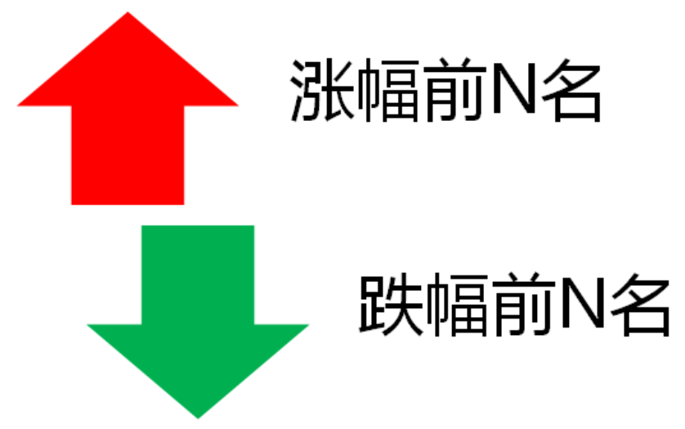
Comparison 1 for TSMOM & XSMOM
Note: (k,h)=(12,1)
The assumption of TSMOM is that the price generation direction of a futures contract will continue to a certain extent (because of the initial under-reaction), and the direction reversal is also a staged process (because of delayed over-reaction). 時間序列動量TSMOM的假設是：某品種的價格產生方向會延續一定幅度(因為最初反應不足)，並且方向反轉也是個階段性過程(因為延遲過度反應)。
For each contract, if its excess return in the past 12 months is positive, go long, otherwise go short. 對於每個合約，若其過去12個月的超額收益為正則做多，反之做空。
The assumption of XSMOM is: the strong will always be strong and the weak will always be weak. Momentum occurs relative to different contracts, not an absolute value.橫截面動量XSMOM的假設是：強者恒強，弱者恒弱。動量是相對出現於品種之間的，而不是以一個絕對數值。
On each date cross-section, contracts that are larger than the average cross-sectional return are long, and vice versa. 在每個日期截面上，大於橫截面平均收益的合約做多，反之做空。
Above go long
Under go short
Notes:
從直覺上，這兩者應該有相關，但其實不完全相同。
所以我先來仔細比較這兩者的差別，再進行後續的分析會較有感覺。
這個return_ew就是橫截面平均return是指：
將同一時間的橫截面上的所有期貨合約return取平均。
然後這個weight_xs就是各合約的return減去這個return_ew，然後正的就long，負的就short。

Slide 23






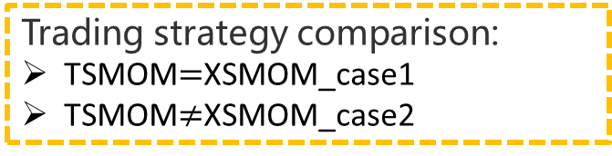















Comparison 2 for TSMOM & XSMOM
Note: (k,h)=(12,1)
TSMOM
$$r_{t−12,t}^{A}=0.26$$
Suppose there are 6 instruments (A, B, C, D, E, and F).
$$r_{t−12,t}^{B}=0.15$$
go long
$$r_{t−12,t}^{C}=0.04$$
$$r_{t−12,t}^{D}=−0.03$$
$$r_{t−12,t}^{E}=−0.05$$
go short
Trading strategy comparison:
TSMOM$=$XSMOM_case1
TSMOM$≠$XSMOM_case2
$$r_{t−12,t}^{F}=−0.07$$
XSMOM
Case1:
Case2:
$$r_{t−12,t}^{A}=0.26$$
$$r_{t−12,t}^{A}=0.17$$
Above go long
$$r_{t−12,t}^{B}=0.15$$
$$r_{t−12,t}^{B}=0.15$$
Above go long
$$r_{t−12,t}^{EW}=0.05$$
$$r_{t−12,t}^{C}=0.04$$
$$r_{t−12,t}^{C}=0.04$$
$$r_{t−12,t}^{C}=0.04$$
$$r_{t−12,t}^{EW}=0.035$$
$$r_{t−12,t}^{D}=−0.03$$
$$r_{t−12,t}^{D}=−0.03$$
Under go short
$$r_{t−12,t}^{E}=−0.05$$
$$r_{t−12,t}^{E}=−0.05$$
Under go short
$$r_{t−12,t}^{F}=−0.07$$
$$r_{t−12,t}^{F}=−0.07$$
Notes:
這邊舉個實際的例子。假設有ABCDEF六個instruments。
1以TSMOM來說，假設它們過去12個月的return值是這樣，就正值就long，負值就short。
2而同樣的return值換到XSMOM策略時，instrument c就會變成要做short。
3case2則是調降return A的值，而此時XSMOM的策略才會跟TSMOM一樣。
思考：
4從這裡會看出，其實XSMOM從概念上來看和TSMOM來看會是相關的對不對？只是要怎麼驗證而已。
5另外，如果instrument C未來一個月是正收益，那其實XSMOM就比TSMOM少賺了。

Slide 24
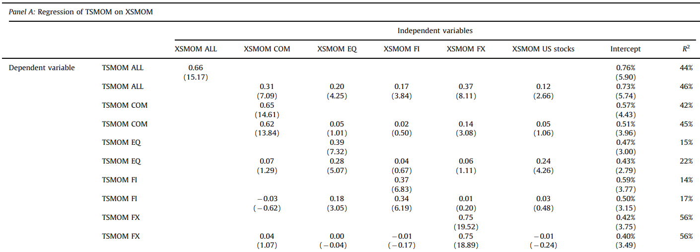
5-1. TSMOM regressed on XSMOM
Table. 5. Panel A reports results from regressions of the 12-month TSMOM on 12-month XSMOM.
So, TSMOM and XSMOM are significantly correlated, but are not the same.
TSMOM still exhibits a significant alpha, and is therefore not fully captured by XSMOM strategies
in these asset classes.
Notes:
Table 5，是說明XSMOM和TS-MOM兩個策略的相關性
1從t-stats來看，兩個策略在商品、股指、債券、外匯都相關性顯著。
2但是，正如這個顯著的alpha值所示，XSMOM不能完全capture TSMOM。
也就是說TSMOM和XSMOM是相關的，但並不相同。

Slide 25
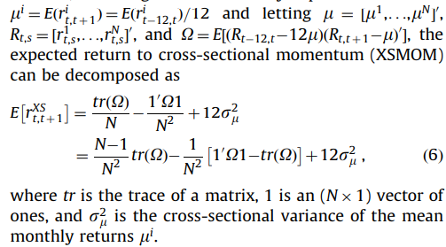
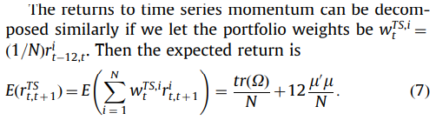
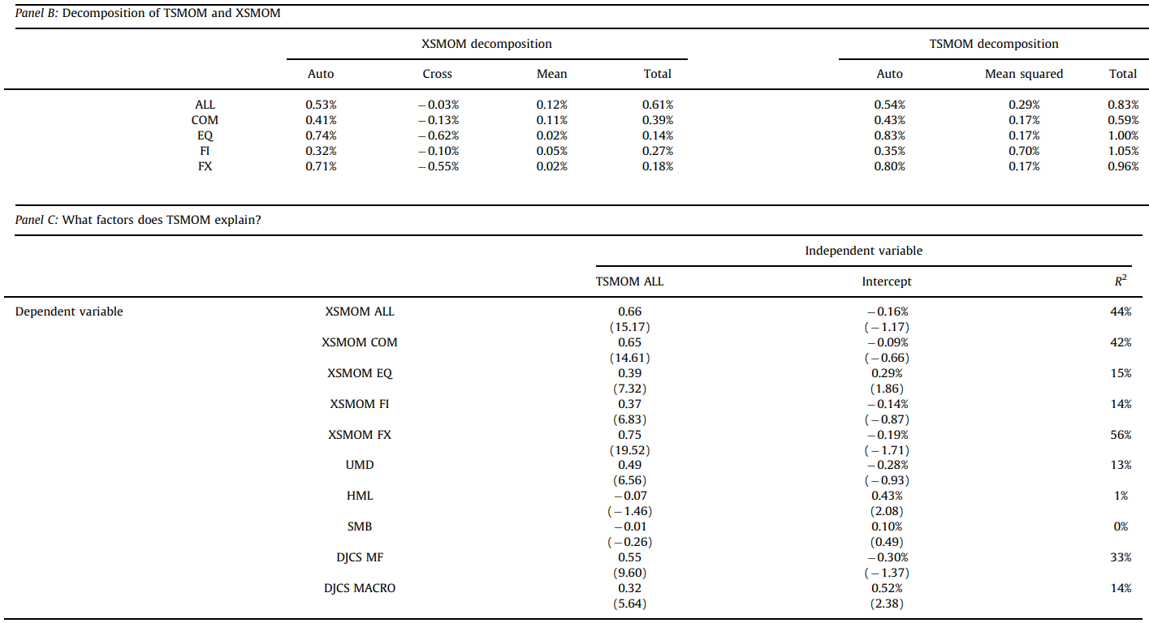
5-2. A simple, formal Decomposition
XSMOM:
TSMOM:
average squared mean return
cross-sectional variation in mean returns
auto-covariance
auto-covariance
cross-covariance
Both decompositions of XSMOM and TSMOM show that the main component is the auto-covariance.
Since the cross-sectional correlation of lead-lag effects among assets contributes negatively to XSMOM, it is not surprising that TSMOM produces higher profits than XSMOM.
Notes:
這裡作者做了一些linear algebra的計算，將XSMOM的期望收益拆解成三個term
1首先第一項是omega的trace，即omega對角線的加總值 (從omega這個matrix來看，會發現對角線其實就是每個期貨合約未來一個月的return，跟自己look back12個月的return，的自變異數。)
2就是非對角線的elements值加總，也就代表cross-covariance的return值。
3第三個term也是跟橫截面有關，不過較不重要。
重要的是xs return拆解後的auto-covariance項的contribution最大。
4同理TSMOM在拆解後，也是auto-covariance項的contribution最大
5整體會發現，兩邊的auto-covariance項都相差不多，然後XSMOM的cross-variance項是negative contribution。
所以驗證TSMOM策略的return就是比XSMOM好就對了。

Slide 26
5-3. Does TSMOM explain XSMOM and other factors?
Table. 5. Panel C reports results from regressions of several XSMOM strategies, the Fama-French momentum, value, and size factors, and two hedge fund indexes on our benchmark TSMOM factor.
TSMOM is able to fully explain XSMOM across all assets.
The intercepts or alphas of XSMOM are statistically no different from zero, suggesting TSMOM captures the return premiums of XSMOM in these markets.
Notes:
1Panel C是橫截面動量的策略收益、fama-French factor以及兩個對沖基金對TSMOM做regression。
主要是想驗證TSMOM對左邊這些變數的可解釋性。
2結果發現，XSMOM的收益，都可以完全用TSMOM來解釋，而反過來則不行。
主要是統計上XSMOM的截距或alpha值與零沒有區別，這表明TSMOM捕獲了這些市場中XSMOM的收益premium。

Slide 27
6. Who trades on trends? Speculators or Hedgers? (Analysis for return and poistion)

Slide 28
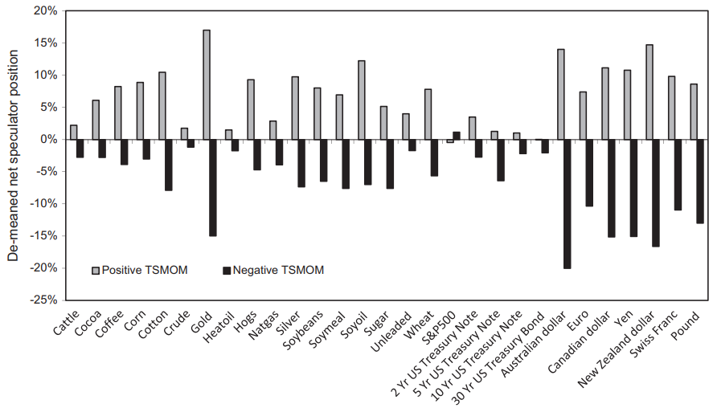
6-1. Who trade on trends?
Fig. 5 plots the average Net speculator position in, respectively, the subsample where the past 12-month return on the contract is positive (“Positive TSMOM” ) and negative (“Negative TSMOM”) de-meaned using the average Net speculator position for each instrument.
speculators
hedgers
speculators have larger positions in an instrument following positive returns than negative returns.
these results indicate that speculators profit, on average, from these position changes at the expense of hedgers.
Notes:
時間的關係，直接講我翻譯的快速版本：
Positive TSMOM(灰色) 可以看成是speculators的position
Negative TSMOM(黑色) 可以看成是hedger的position
會發現大部分期貨合約中，positive的值都比negative多，
這證實了speculator從TSMOM策略中賺到錢，並且是以hedger為代價。
------------------------------------------------
右上顯示淨投機者頭寸的計算(long減short，然後除以未平倉量)
而這張圖可以看出各個期貨合約中，淨投機者頭寸相對於正的TSMOM訊號與負的TSMOM訊號。
會發現大部分期貨合約中，positive的值都比negative多，
這證實了speculator從TSMOM策略中賺到錢，並且是以hedger為代價。
--------------------------------------------------------------------
投機者在正收益之後的工具中比在負收益之後的工具中的位置更大。
除了標準普爾500期貨之外，所有合約都存在這種投機頭寸的趨勢追踪模式。
由於我們還知道時間序列動量與正的異常收益相關，因此這些結果表明，投機者平均會從這些頭寸變化中獲利，而以套期保值者為代價。

Slide 29
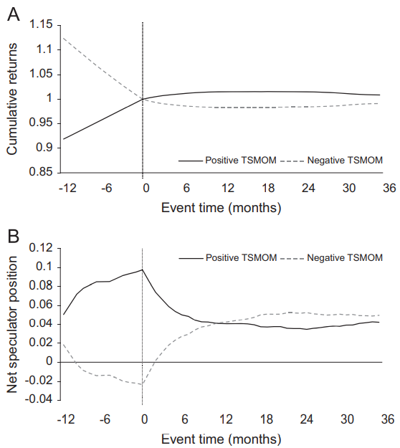
6-2. The evolution of TSMOM
Panel A of Fig. 6 shows the cumulative returns conditional on positive and negative TSMOM.
To the right of the event date, the positive pre-formation returns continue upward after the portfolio formation for about a year, consistent with a TSMOM effect, and then partially reverse thereafter.
This is consistent with both initial under-reaction and delayed over-reaction as predicted by sentiment theories.
speculators
hedgers
To the right of the event date, speculators appear to reduce their trend chasing up. Conversely, hedgers appear to be increasing their positions steadily in the direction of the trend.
This suggests that if over-reaction is caused by such trading, it would have to come from hedgers, not speculators.
these results also suggest that trading positions are closely linked to the profitability of TSMOM, where speculators appear to be profiting from trends and reversals at the expense of hedgers.
“event date” (portfolio formation date)
speculators
hedgers
Panel B shows the evolution of Net speculator positions that coincide with the positive and negative TSMOM returns.
Notes:
最後，我們來看一下TSMOM這個策略在市場中的evolution。
上圖A是累積收益的evolution，下圖B則是position的evolution。
一樣，我們把實線看成是speculator，虛線看成是hedger，較好理解。
1在event date的右邊，我們看到positive TSMOM的portfolio形成後的累積收益，繼續微幅上升一年，這與TSMOM效應一致，然後部分反轉。
2與sentiment theory所預測的，這與最初的反應不足和延遲的過度反應都一致。
3而在panel B的曲線中，在event date後投機者似乎減少了追逐趨勢。相反，hedger似乎正在朝趨勢的方向穩步增加頭寸。
4這表明，如果過度反應是由此類交易引起的，那將必須來自hedger，而不是投機者。
5這些結果還表明，投機者和hedger的交易頭寸與TSMOM的獲利能力緊密相關，投機者似乎從趨勢和逆轉中獲利，卻以套期保值者為代價。
等情感理論所預測的，這與最初的反應不足和延遲的反應過度都一致。一年後的逆轉表明反應過度，而僅形成後上升趨勢的一部分被逆轉的事實表明反應不足似乎也是故事的一部分。同樣，負面的預成型趨勢將持續一年，直到部分扭轉。

Slide 30
7. Conclusion
Notes:
Our previous results show a significant relationship between time series momentum and cross-sectional momentum. In this section, we explore that relationship further and determine how much overlap and difference exist between our time series momentum strategies and the cross-sectional momentum strategies commonly used in the literature. 我們之前的結果表明時間序列動量和橫截面動量之間存在顯著的關係。在本節中，我們將進一步探討這種關係，並確定我們的時間序列動量策略與文獻中常用的橫截面動量策略之間存在多少重疊和差異。

Slide 31
7. Conclusion
We find a significant TSMOM effect that is remarkably consistent across the 58 futures contracts and several major asset classes we study over the last 25 years.
The TSMOM effect is distinct from XSMOM, though the two are related. Decomposing both TSMOM and XSMOM profits, we find that the dominant force to both strategies is significant positive auto-covariance between a security's excess return next month and it's lagged 1-year return.
This evidence is consistent with initial under-reaction stories, but may also be consistent with delayed over-reaction theories of sentiment as the TSMOM effect partially reverses after one year.
TSMOM exhibits strong and consistent performance across many diverse asset classes, has small loadings on standard risk factors, and performs well in extreme periods, all of which present a challenge to the random walk hypothesis and to standard rational pricing models.
the link between TSMOM returns and the positions of speculators and hedgers indicates that speculators profit from TSMOM at the expense of hedgers. This evidence is consistent with speculators earning a premium via TSMOM for providing liquidity to hedgers.
TSMOM represents one of the most direct tests of the random walk hypothesis and a number of prominent behavioral and rational asset pricing theories. Our findings present new evidence and challenges for those theories and for future research.
Notes:
1發現時間序列動量效應，在過去25年中的四大類別資產中的58個期貨合約，這種效應非常一致。
2時間序列動量效應與橫截面動量不同，儘管兩者是相關的。
3證實TSMOM與最初的反應不足故事是一致的，但也可能與延遲的反應過度理論有關，因為時間序列動量效應在一年後會部分逆轉。
4TSMOM在極端時期表現良好。
5speculator藉由TSMOM賺取利潤，並且是以hedger的投資避險行為為代價。
6TSMOM表示了對random walk hypothesis的最直接檢驗之一。這篇paper的發現為這些理論和未來研究提供了新的證據和挑戰。
--------------------------------------------------
時間序列動量回報與投機者和套期保值者的部位之間的聯繫表明，投機者從時間序列動量中獲利，而以套期保值者為代價。這與投機者通過時間序列動量賺取溢價以向套期保值者提供流動性相一致。

Slide 32
Thanks for your listening

Slide 33


